Slide 1
Concept of Compiler and Interpreter
Compiler
Compiler converts source code to object code. It is a program that converts instructions into a machine-code or lower-level form so that they can be read and executed by a computer. Compiler checks errors as a whole at the end.
Interpreter
Converts source code to object code. a program that can analyze and execute a program line by line.

Slide 2
Compiler VS interpreter
BASIS FOR COMPARISON | COMPILER | INTERPRETER
Input | It takes an entire program at a time. | It takes a single line of code or instruction at a time.
Working mechanism | The compilation is done before execution. | Compilation and execution take place simultaneously.
Speed | Comparatively faster | Slower
Errors | Display all errors after compilation, all at the same time. | Displays error of each line one by one.
Error detection | Difficult | Easier comparatively
Pertaining Programming languages | C, C++, C#, Scala, typescript uses compiler. | PHP, Perl, Python, Ruby uses an interpreter.

Slide 3
Operating system
An operating system (OS) is system software that manages computer hardware, software resources, and provides common services for computer programs.
Time-sharing operating systems schedule tasks for efficient use of the system and may also include accounting software for cost allocation of processor time, mass storage, printing, and other resources.
For hardware functions such as input and output and memory allocation, the operating system acts as an intermediary between programs and the computer hardware, although the application code is usually executed directly by the hardware and frequently makes system calls to an OS function or is interrupted by it. Operating systems are found on many devices that contain a computer – from cellular phones and video game consoles to web servers and supercomputers.

Slide 4
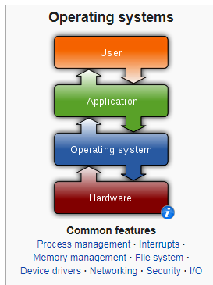

Slide 5
Need of Operating System:
OS as a platform for Application programs: Operating system provides a platform, on top of which, other programs, called application programs can run. These application programs help the users to perform a specific task easily. It acts as an interface between the computer and the user
Managing Input-Output unit: Operating System also allows the computer to manage its own resources such as memory, monitor, keyboard, printer etc. The operating system controls the various system input-output resources and allocates them to the users or programs as per their requirement.
Consistent user interface: Operating System provides the user an easy-to-work user interface, so the user doesn’t have to learn a different UI every time and can focus on the content and be productive as quickly as possible. Operating System provides templates, UI components to make the working of a computer, really easy for the user.
Multitasking: Operating System manages memory and allow multiple programs to run in their own space and even communicate with each other through shared memory. Multitasking gives users a good experience as they can perform several tasks on a computer at a time.

Slide 6
Functions of an Operating System
An operating system has variety of functions to perform. Some of the prominent functions of an operating system can be broadly outlined as:
1.Processor Management: This deals with management of the Central Processing Unit (CPU). The operating system takes care of the allotment of CPU time to different processes. When a process finishes its CPU processing after executing for the allotted time period, this is called scheduling. There are various type of scheduling techniques that are used by the operating systems:
Shortest Job First(SJF): Process which need the shortest CPU time are scheduled first.
Round Robin Scheduling: Each process is assigned a fixed CPU execution time in cyclic way.
Priority Based scheduling (Non Preemptive): In this scheduling, processes are scheduled according to their priorities, i.e., highest priority process is schedule first. If priorities of two processes match, then schedule according to arrival time

Slide 7
2.Device Management: The Operating System communicates with hardware and the attached devices and maintains a balance between them and the CPU. This is all the more important because the CPU processing speed is much higher than that of I/O devices. In order to optimize the CPU time, the operating system employs two techniques – Buffering and Spooling.
Buffering: In this technique, input and output data is temporarily stored in Input Buffer and Output Buffer. Once the signal for input or output is sent to or from the CPU respectively, the operating system through the device controller moves the data from the input device to the input buffer and for the output device to the output buffer. In case of input, if the buffer is full, the operating system sends a signal to the program which processes the data stored in the buffer. When the buffer becomes empty, the program informs the operating system which reloads the buffer and the input operation continues.

Slide 8
Spooling (Simultaneous Peripheral Operation on Line): This is a device management technique used for processing of different tasks on the same input/output device. When there are various users on a network sharing the same resource then it can be a possibility that more than one user might give it a command at the same point of time. So, the operating system temporarily stores the data of every user on the hard disk of the computer to which the resource is attached. The individual user need not wait for the execution process to be completed. Instead the operating system sends the data from the hard disk to the resource one by one. Example: printer

Slide 9
3. Memory management: In a computer, both the CPU and the I/O devices interact with the memory. When a program needs to be executed it is loaded onto the main memory till the execution is completed. Thereafter that memory space is freed and is available for other programs. The common memory management techniques used by the operating system are Partitioning and Virtual Memory.
Partitioning: The total memory is divided into various partitions of same size or different sizes. This helps to accommodate number of programs in the memory. The partition can be fixed i.e. remains same for all the programs in the memory or variable i.e. memory is allocated when a program is loaded on to the memory.
Virtual Memory: This is a technique used by the operating systems which allow the user can load the programs which are larger than the main memory of the computer. In this technique the program is executed even if the complete program can not be loaded inside the main memory leading to efficient memory utilization.

Slide 10
4. File Management: The operating System manages the files, folders and directory systems on a computer. Any data on a computer is stored in the form of files and the operating system keeps information about all of them using File Allocation Table (FAT). The FAT stores general information about files like filename, type (text or binary), size, starting address and access mode (sequential/indexed sequential/direct/relative). The file manager of the operating system helps to create, edit, copy, allocate memory to the files and also updates the FAT. The operating system also takes care that files are opened with proper access rights to read or edit them.

Slide 11
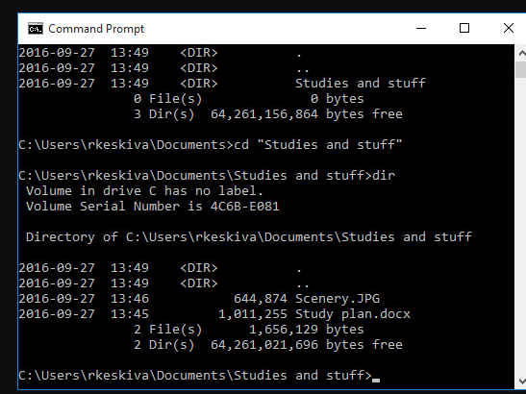
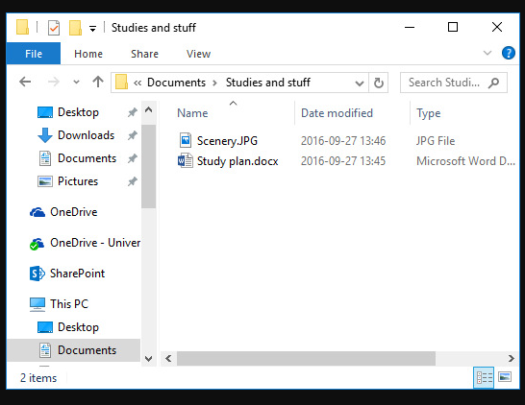
User Interface
A user interface (UI) refers to the part of an operating system, program, or device that allows a user to enter and receive information. A text-based user interface (see the image to the left) displays text, and its commands are usually typed on a command line using a keyboard. With a graphical user interface (see the right-hand image), the functions are carried out by clicking or moving buttons, icons and menus by means of a pointing device.

Slide 12
Cloud Computing
Cloud computing is the on-demand availability of computer system resources, especially data storage and computing power, without direct active management by the user. The term is generally used to describe data centers available to many users over the Internet. Large clouds, predominant today, often have functions distributed over multiple locations from central servers.
Cloud computing relies on sharing of resources
cloud computing allows companies to avoid or minimize up-front IT infrastructure costs.
cloud computing allows enterprises to get their applications up and running faster, with improved manageability and less maintenance.

Slide 13
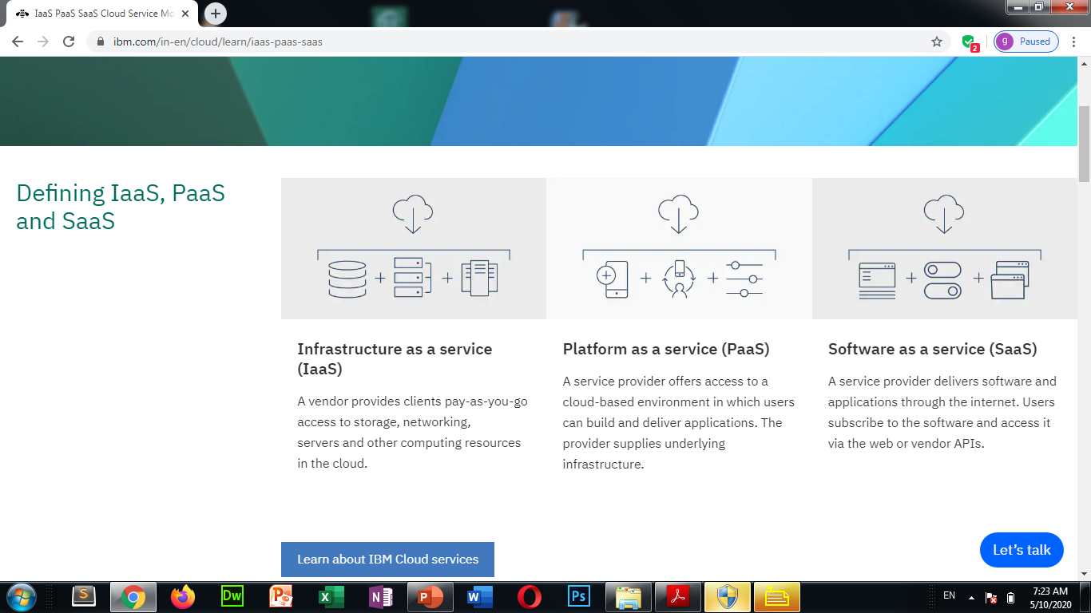
Cloud Services
Organizations use their own platforms and applications within a service provider’s infrastructure.

Slide 14
Key features
Instead of purchasing hardware outright, users pay for IaaS on demand.
Infrastructure is scalable depending on processing and storage needs.
Saves enterprises the costs of buying and maintaining their own hardware.
Because data is on the cloud, there can be no single point of failure.

Slide 15
In addition to storage and other computing resources, users are able to use a suite of prebuilt tools to develop, customize and test their own applications.
Key features
PaaS provides a platform with tools to test, develop and host applications in the same environment.
Enables organizations to focus on development without having to worry about underlying infrastructure.
Providers manage security, operating systems, server software and backups.
Facilitates collaborative work even if teams work remotely.

Slide 16
Users do not install applications on their local devices. Instead, the applications reside on a remote cloud network accessed through the web or an API. Through the application, users can store and analyze data and collaborate on projects.

Slide 17
Key features
SaaS vendors provide users with software and applications via a subscription model.
Users do not have to manage, install or upgrade software; SaaS providers manage this.
Data is secure in the cloud; equipment failure does not result in loss of data.
Use of resources can be scaled depending on service needs.
Applications are accessible from almost any internet-connected device, from virtually anywhere in the world.

Slide 18
What is a public cloud?
A public cloud is a cloud service offered to multiple customers by a cloud provider. The term "public cloud" is used to differentiate between the original cloud model of services accessed over the Internet and the private cloud model. Public clouds include SaaS, PaaS, and IaaS services.
Like all cloud services, a public cloud service runs on remote servers that a provider manages. Customers of that provider access those services over the Internet.

Slide 19
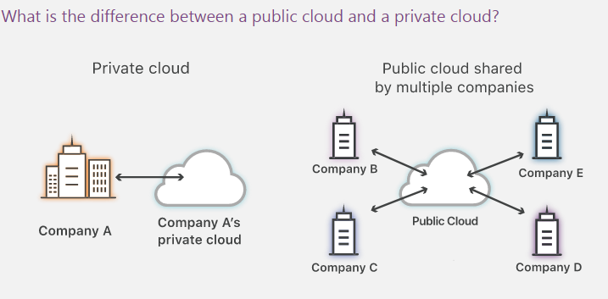

Slide 20
A private cloud is a cloud service that is not shared with any other organization. The private cloud user has the cloud to themselves.
By contrast, a public cloud is a cloud service that shares computing services among different customers, even though each customer's data and applications running in the cloud remain hidden from other cloud customers.
A public cloud is like renting an apartment, while a private cloud is like renting a similarly sized house. The house is more private, but it also typically costs more to rent, and it's not the most efficient use of resources. Maintenance in the apartment is handled by the building supervisor, but it's harder to get a contractor out to fix the house (sometimes, the tenant may have to do it themselves).
There are hosted private clouds, which are offered by a third party cloud provider, and internal private clouds, which are managed and maintained by an organization internally.

Slide 21
Blockchain Technology
Blockchain technology is most simply defined as a decentralized, distributed ledger that records the provenance of a digital asset.
Blockchain, sometimes referred to as Distributed Ledger Technology (DLT), makes the history of any digital asset unalterable and transparent through the use of decentralization and cryptographic hashing.
A simple analogy for understanding blockchain technology is a Google Doc. When we create a document and share it with a group of people, the document is distributed instead of copied or transferred. This creates a decentralized distribution chain that gives everyone access to the document at the same time. No one is locked out awaiting changes from another party, while all modifications to the doc are being recorded in real-time, making changes completely transparent.

Slide 22
Thank you

